Slide 1
Portuguese Banking Institution
Direct Telemarketing - Campaign 2
Analyze Subscription for Bank Term Deposit

Slide 2
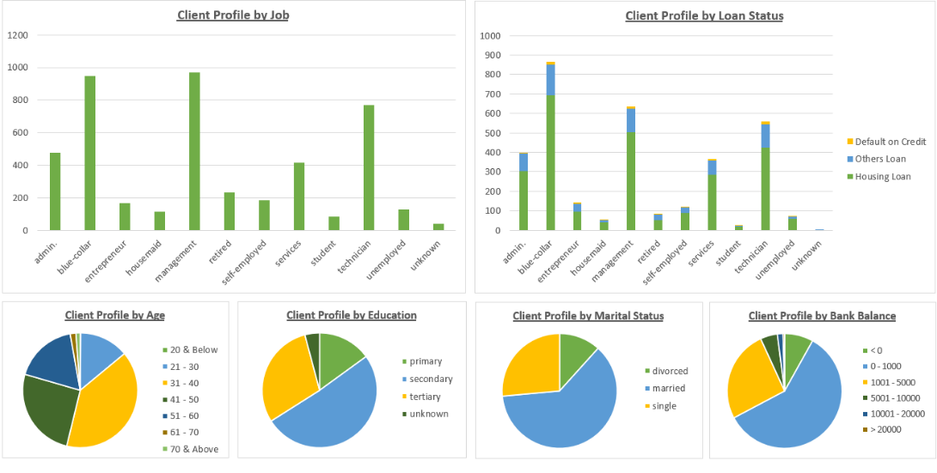
Client Composition Profile
Total Client Approached : 4521 Number of Subscription : 521 (11.5%)

Slide 3
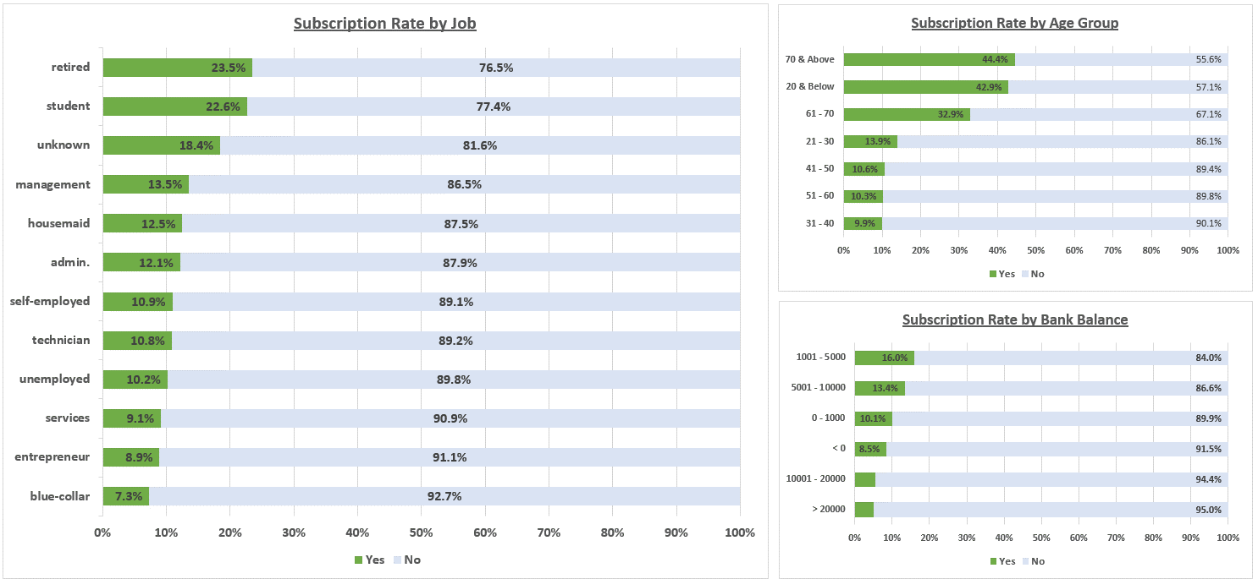
Subscription Rate (Client Related)
Total Client Approached : 4521 Number of Subscription : 521 (11.5%)
* 3 out of 7 Count. Sample Size too small to be meaningful
*

Slide 4
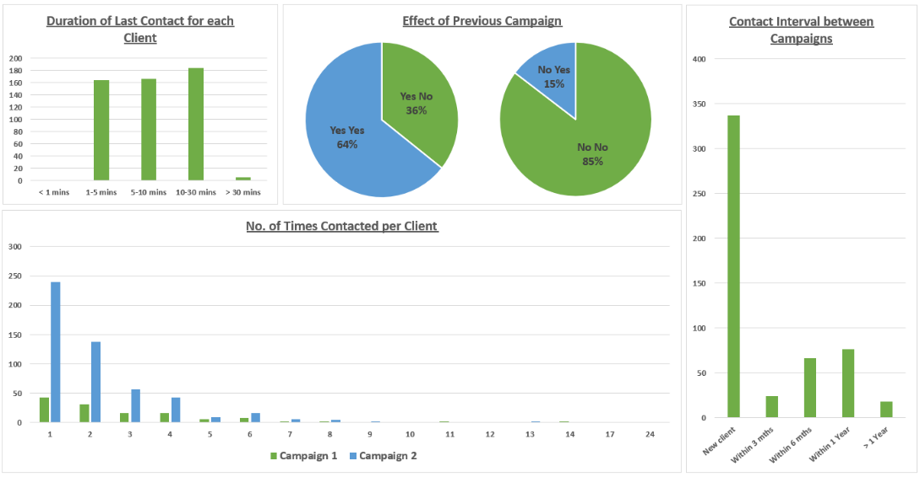
Subscription Composition (Campaign Related)
Total Client Approached : 4521 Number of Subscription : 521 (11.5%)

Slide 5
Summarize
Campaign on Time Deposit should be more focus on Senior/Retiree (age 61 and above),
who is more likely to Subscribe for it.
Those that already had Time Deposit is more likely to Subscribe for it again.
Should Actively looking for new Client.
Minimum Deposit should not be too high (recommend to set between $1,000 to $5,000)
Interval between Campaigns should not be too close (recommend between 6 months to a year)
For Efficiency, contact each Client 1-3 times, do not exceed 30 mins for each call.
No Pestering or Hard Selling.

Slide 6
End of Report

Slide 7
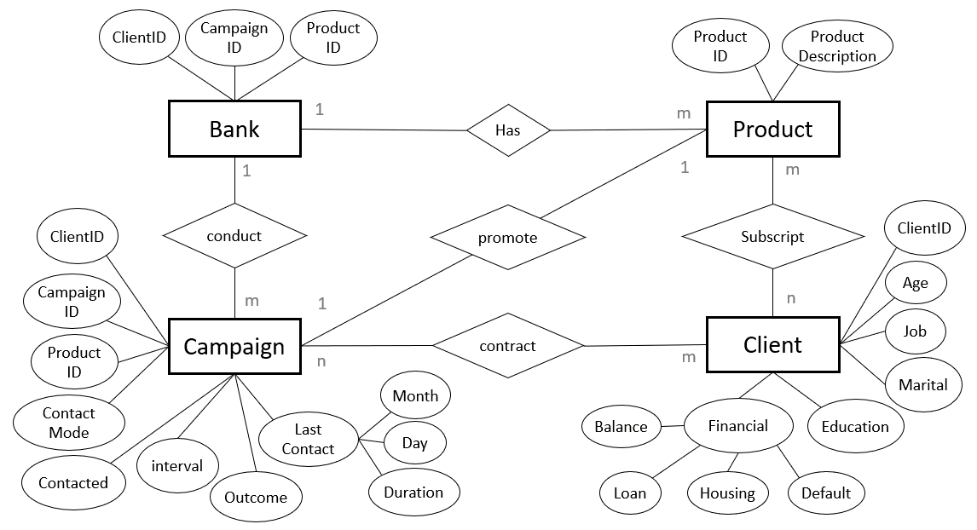
Appendix – ER Diagram

Slide 8
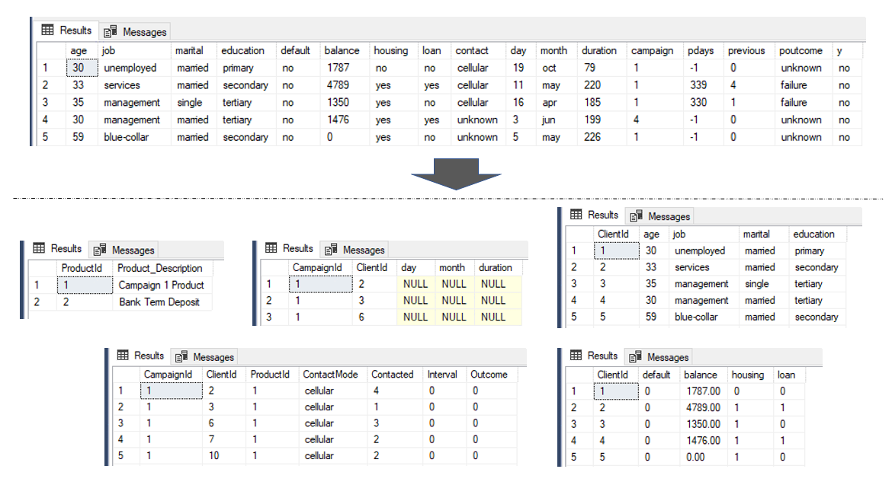
Appendix – Normalization
https://archive.ics.uci.edu/ml/datasets/Bank+Marketing

Slide 9
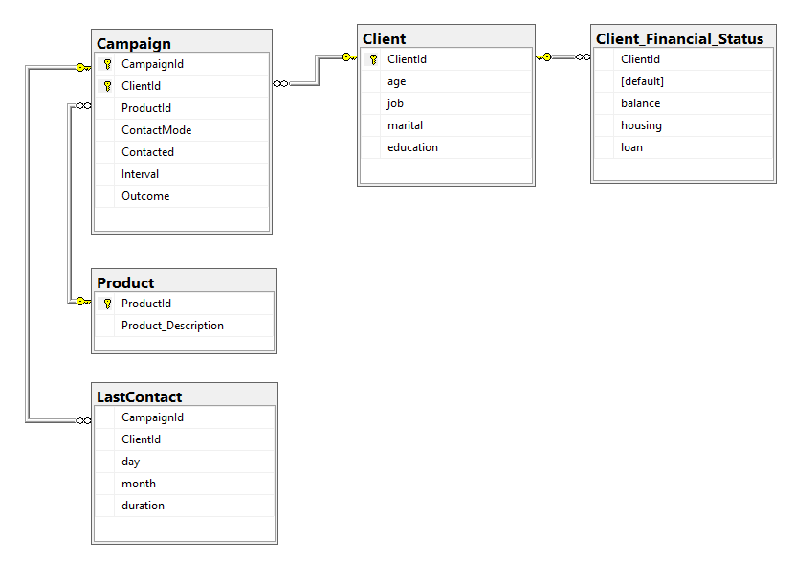
Appendix – Database Diagram

Slide 10
End of Presentation
Thank you !

